Slide 1
Listening and integrated skills A2
Instructor: Nguyen Ha Phuong

Slide 2
ABOUT ME
EDUCATION:
B.A. in English studies, Hanoi University
Master of TESOL & FLT, Canberra University
CURRENT WORK EXPERIENCE:
English lecturer, Thang Long University
English lecturer, Distance Education Center (Hanoi University)
CONTACT INFO:
Email: phuongnhtttx@hanu.edu.vn
Phone number: 0332104258

Slide 3
COURSE INTRODUCTION
Duration: 11 weeks (online classes) + 1 week (progress test)
Attendance: ≥ 80%
Material: Pathways 1 Listening, Speaking and Critical thinking (3rd ed.)
Assessment level: A2
Participation (in-class participation + SPARK completion): 10%
Progress test: 30%
Final test: 60%

Slide 4
Unit 1: Exploring work
Page 1 - 20

Slide 5
Lesson objectives
By the end of the lesson, students will be able to:
identify word families.
listen for repeated words and ideas.
make inferences.

Slide 6
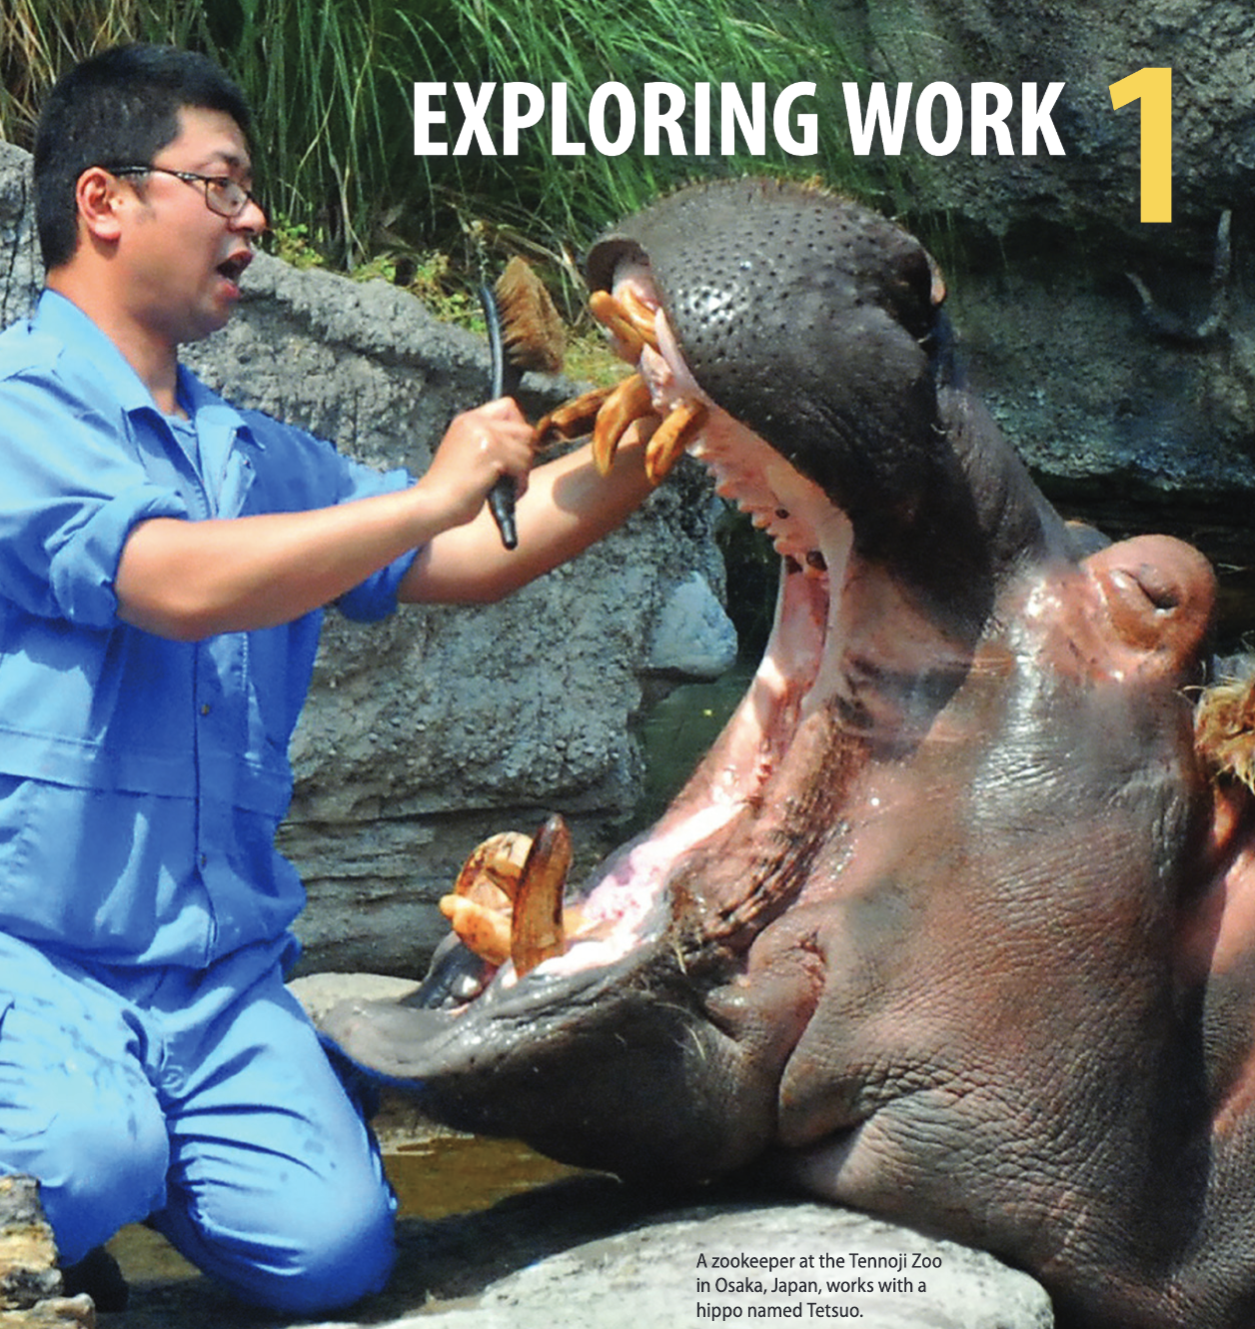
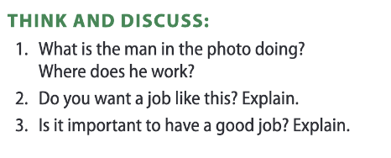

Slide 7
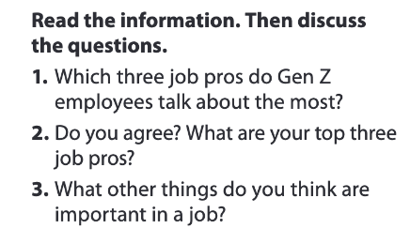

Lead-in
Pages 2-3

Slide 8
TABLE OF CONTENTS
01
02
03
04
05
VOCABULARY A
LISTENING A
VIDEO WATCHING
VOCABULARY B
LISTENING B

Slide 9

01
Vocabulary A

Slide 10

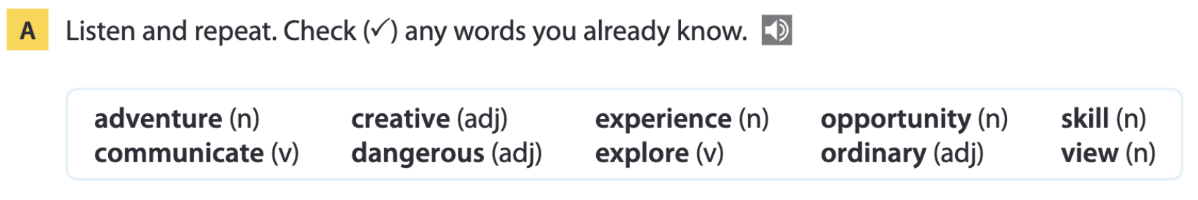
Page 4

Slide 11
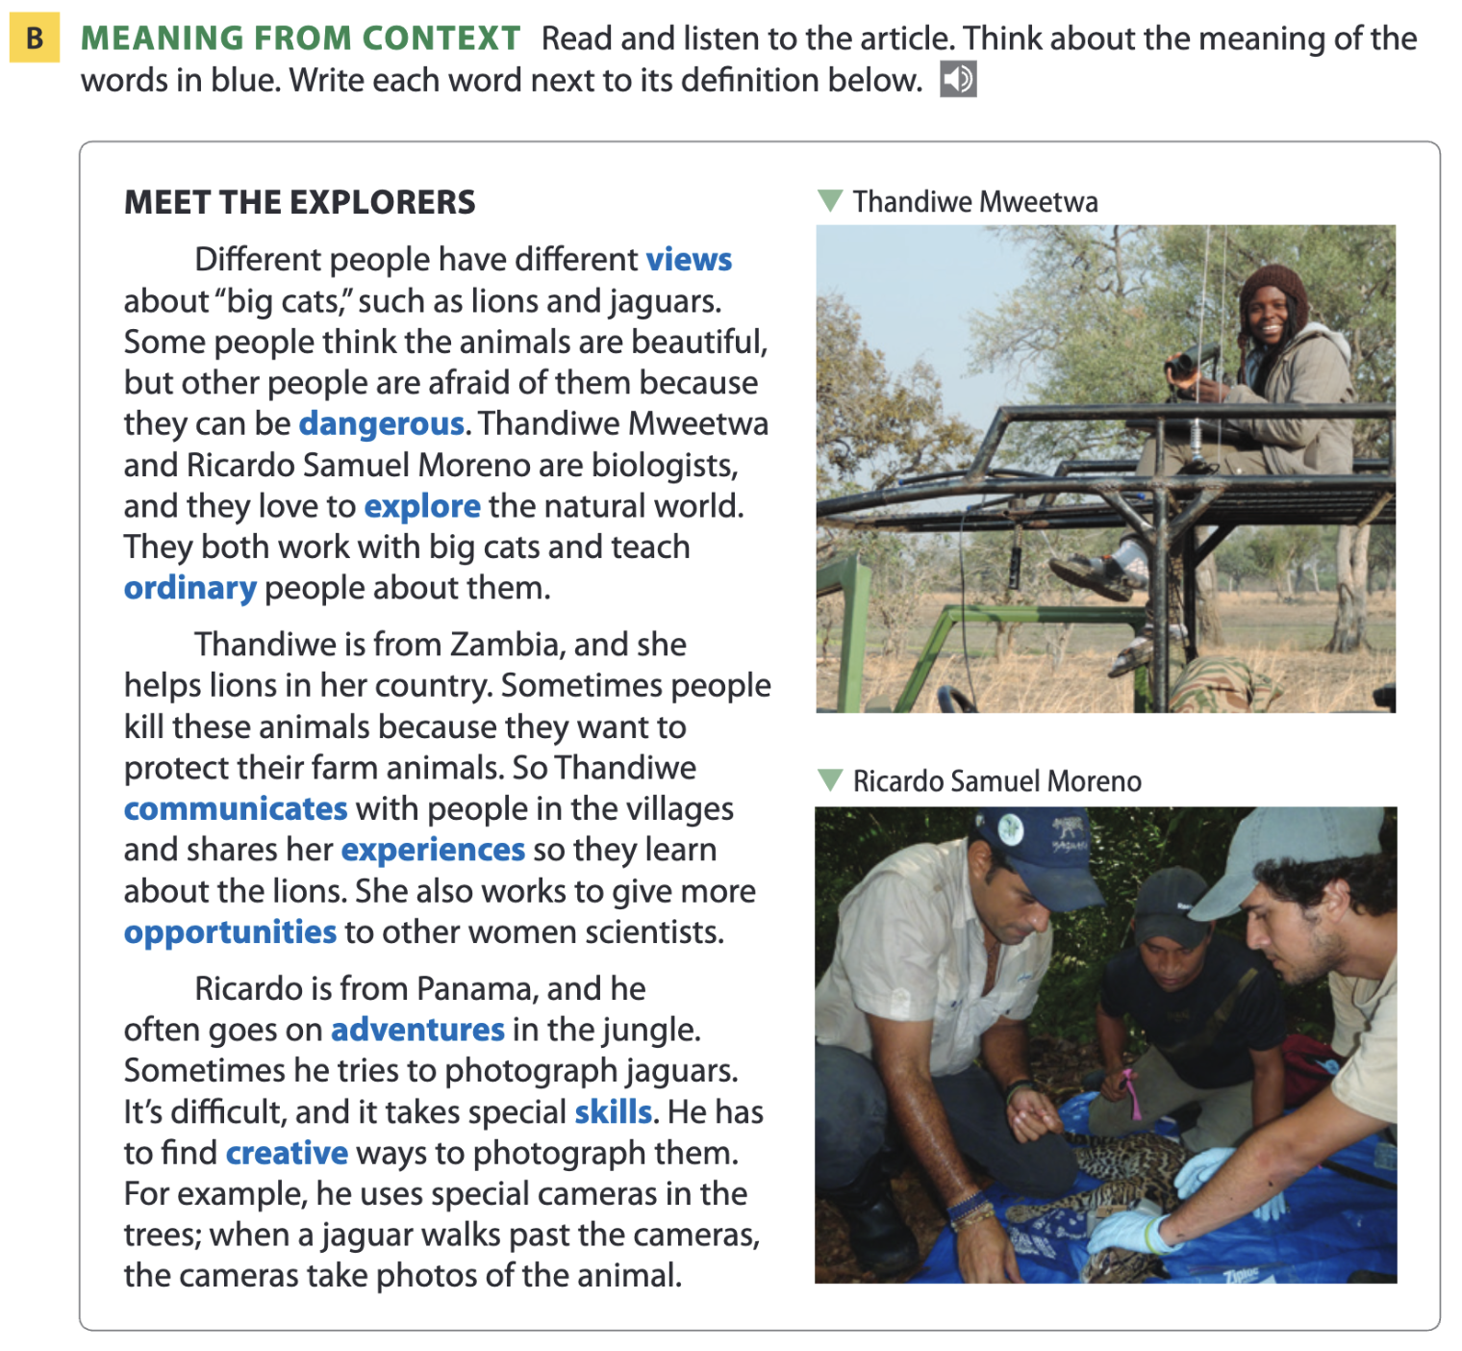
Page 4

Slide 12
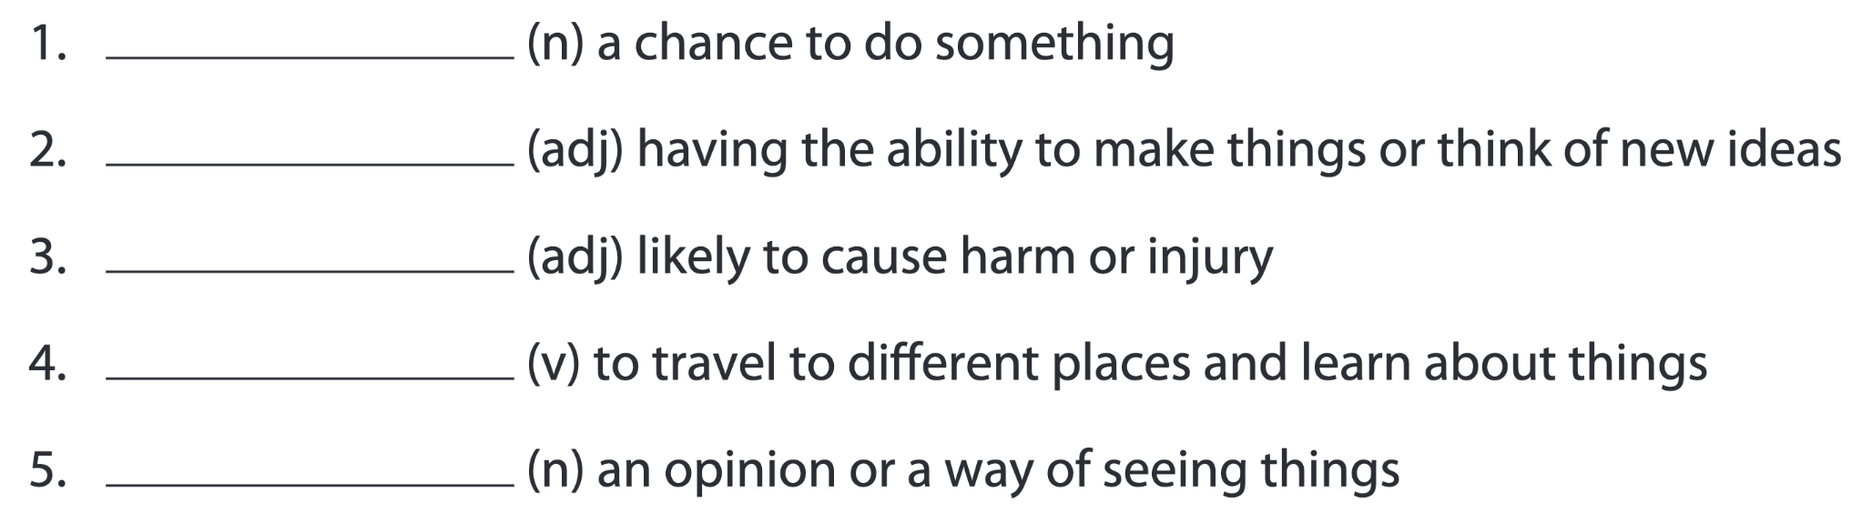
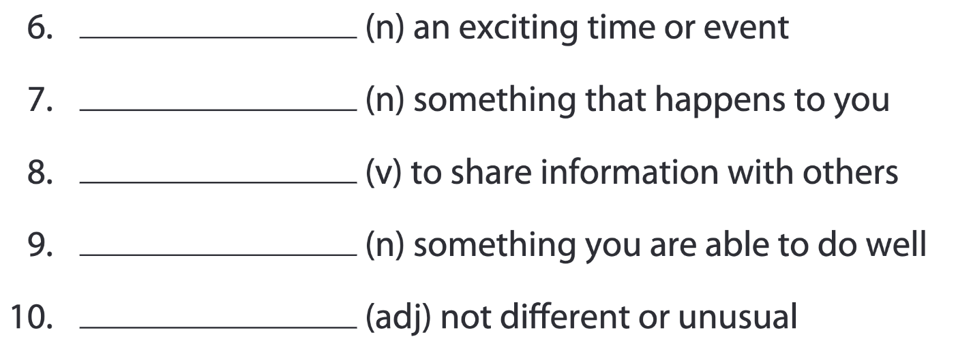
Pages 4-5
opportunity
creative
dangerous
explore
view
adventure
experience
communicate
skill
ordinary

Slide 13
Vocabulary list
opportunity /ˌɒp.əˈtjuː.nə.ti/ (n) – cơ hội creative /kriˈeɪ.tɪv/ (adj) – sáng tạo dangerous /ˈdeɪn.dʒər.əs/ (adj) – nguy hiểm explore /ɪkˈsplɔːr/ (v) – khám phá view /vjuː/ (n) – quan điểm, cách nhìn adventure /ədˈven.tʃər/ (n) – cuộc phiêu lưu experience /ɪkˈspɪə.ri.əns/ (n) – trải nghiệm communicate /kəˈmjuː.nɪ.keɪt/ (v) – giao tiếp skill /skɪl/ (n) – kỹ năng ordinary /ˈɔː.dɪ.nə.ri/ (adj) – bình thường

Slide 14
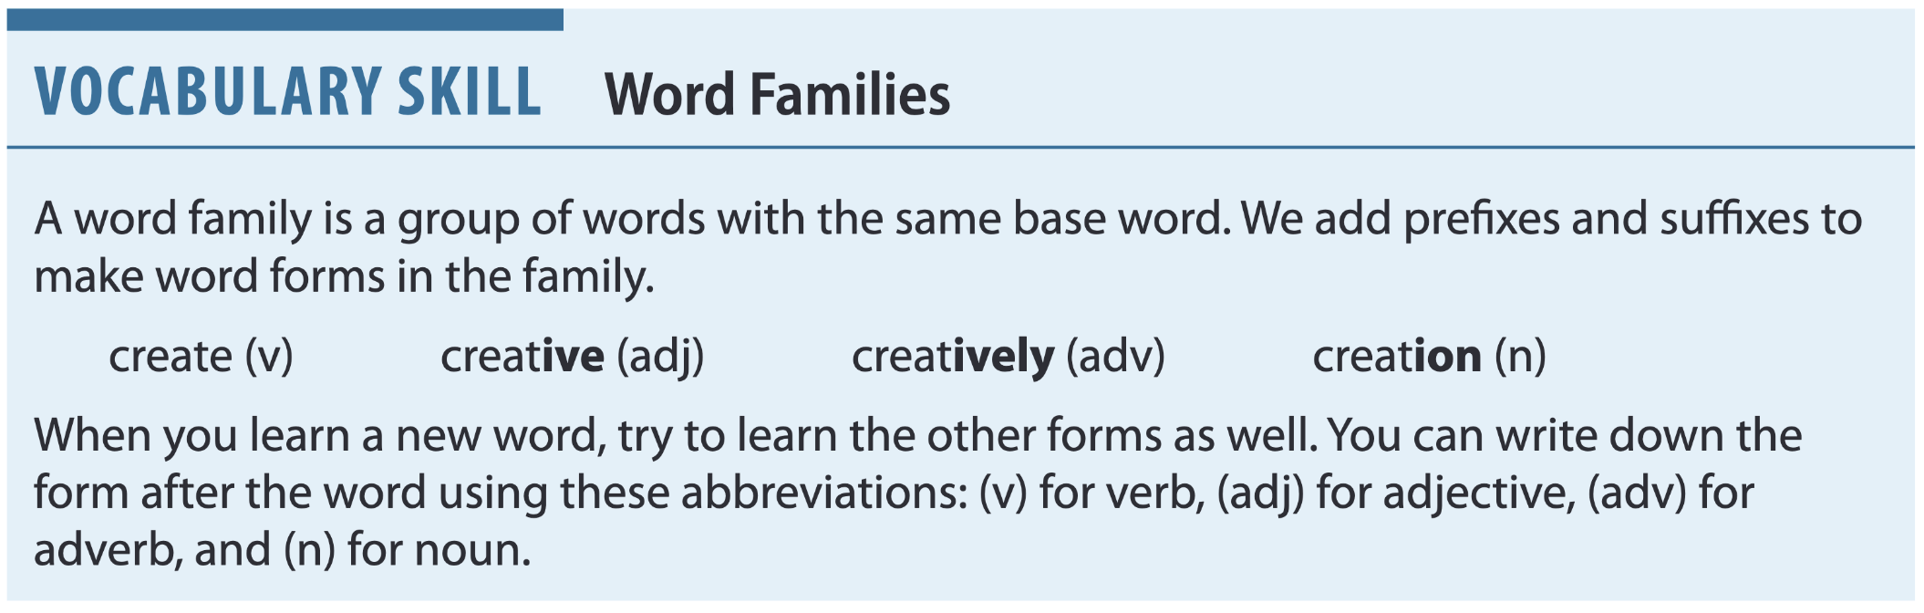
Page 5

Slide 15
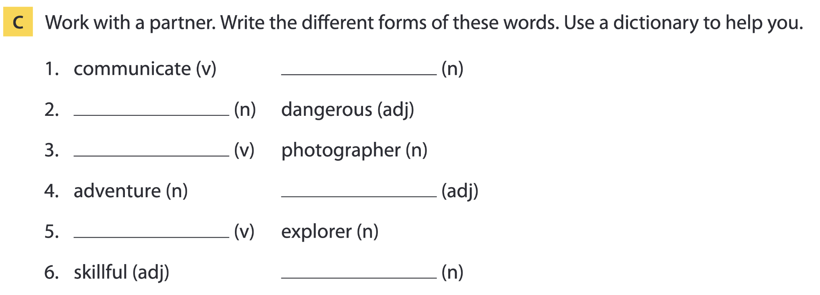
Page 5
communication
danger
photograph
adventurous
explore
skill

Slide 16
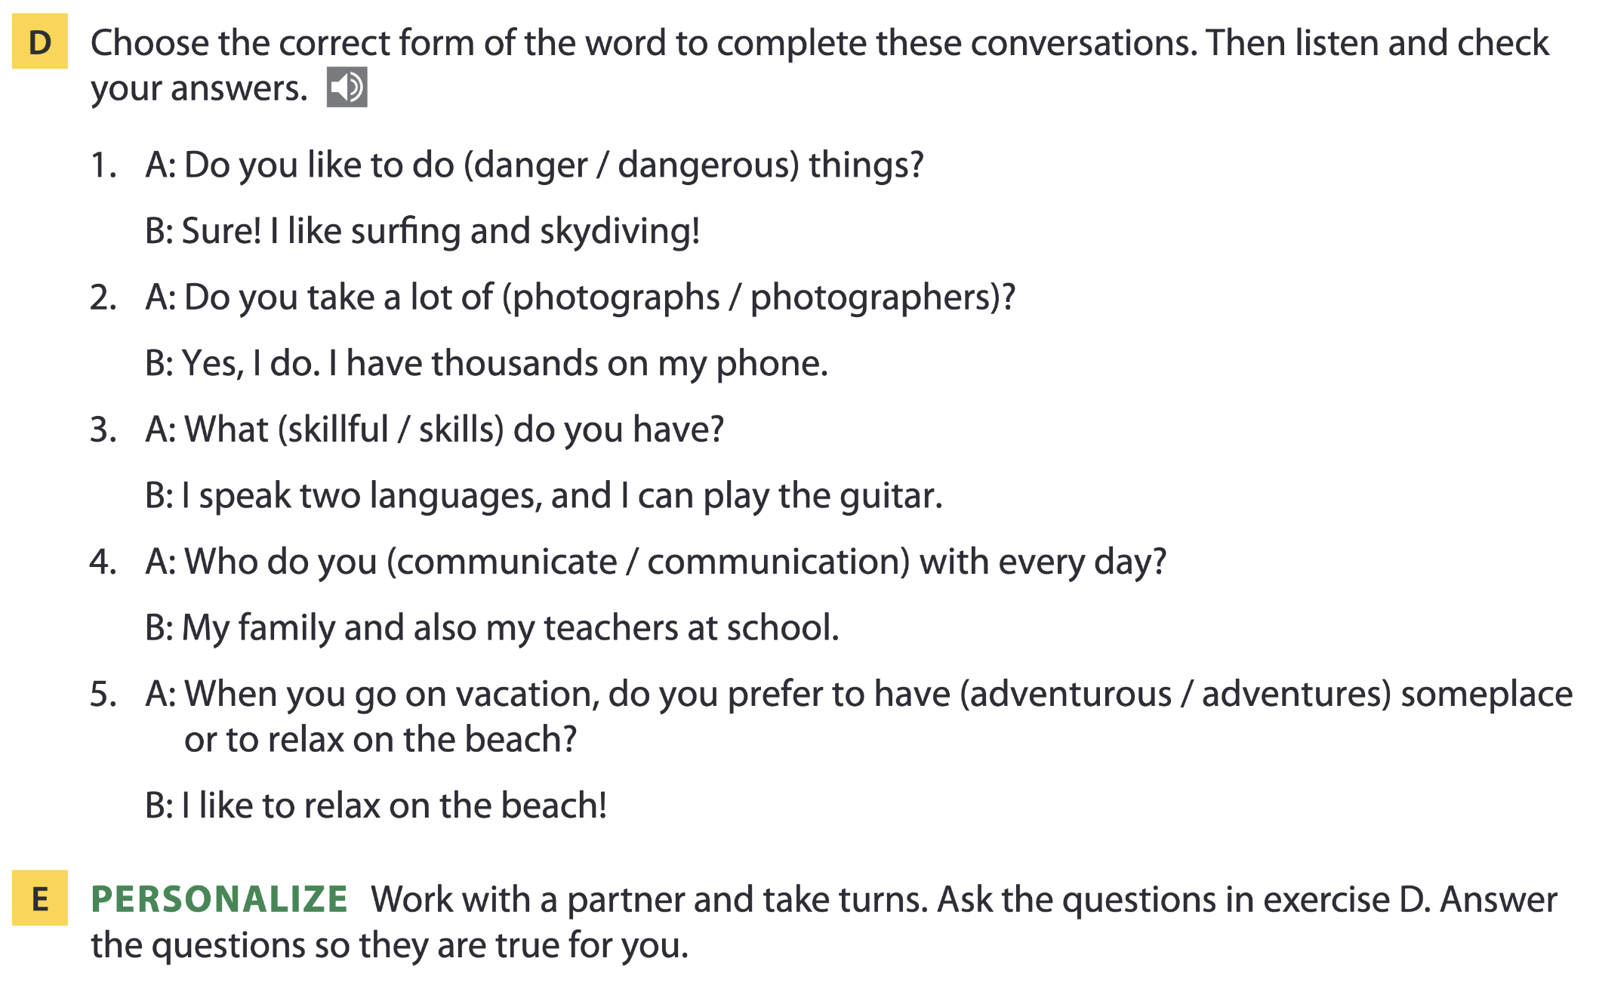
Page 5

Slide 17

02
Listening A

Slide 18
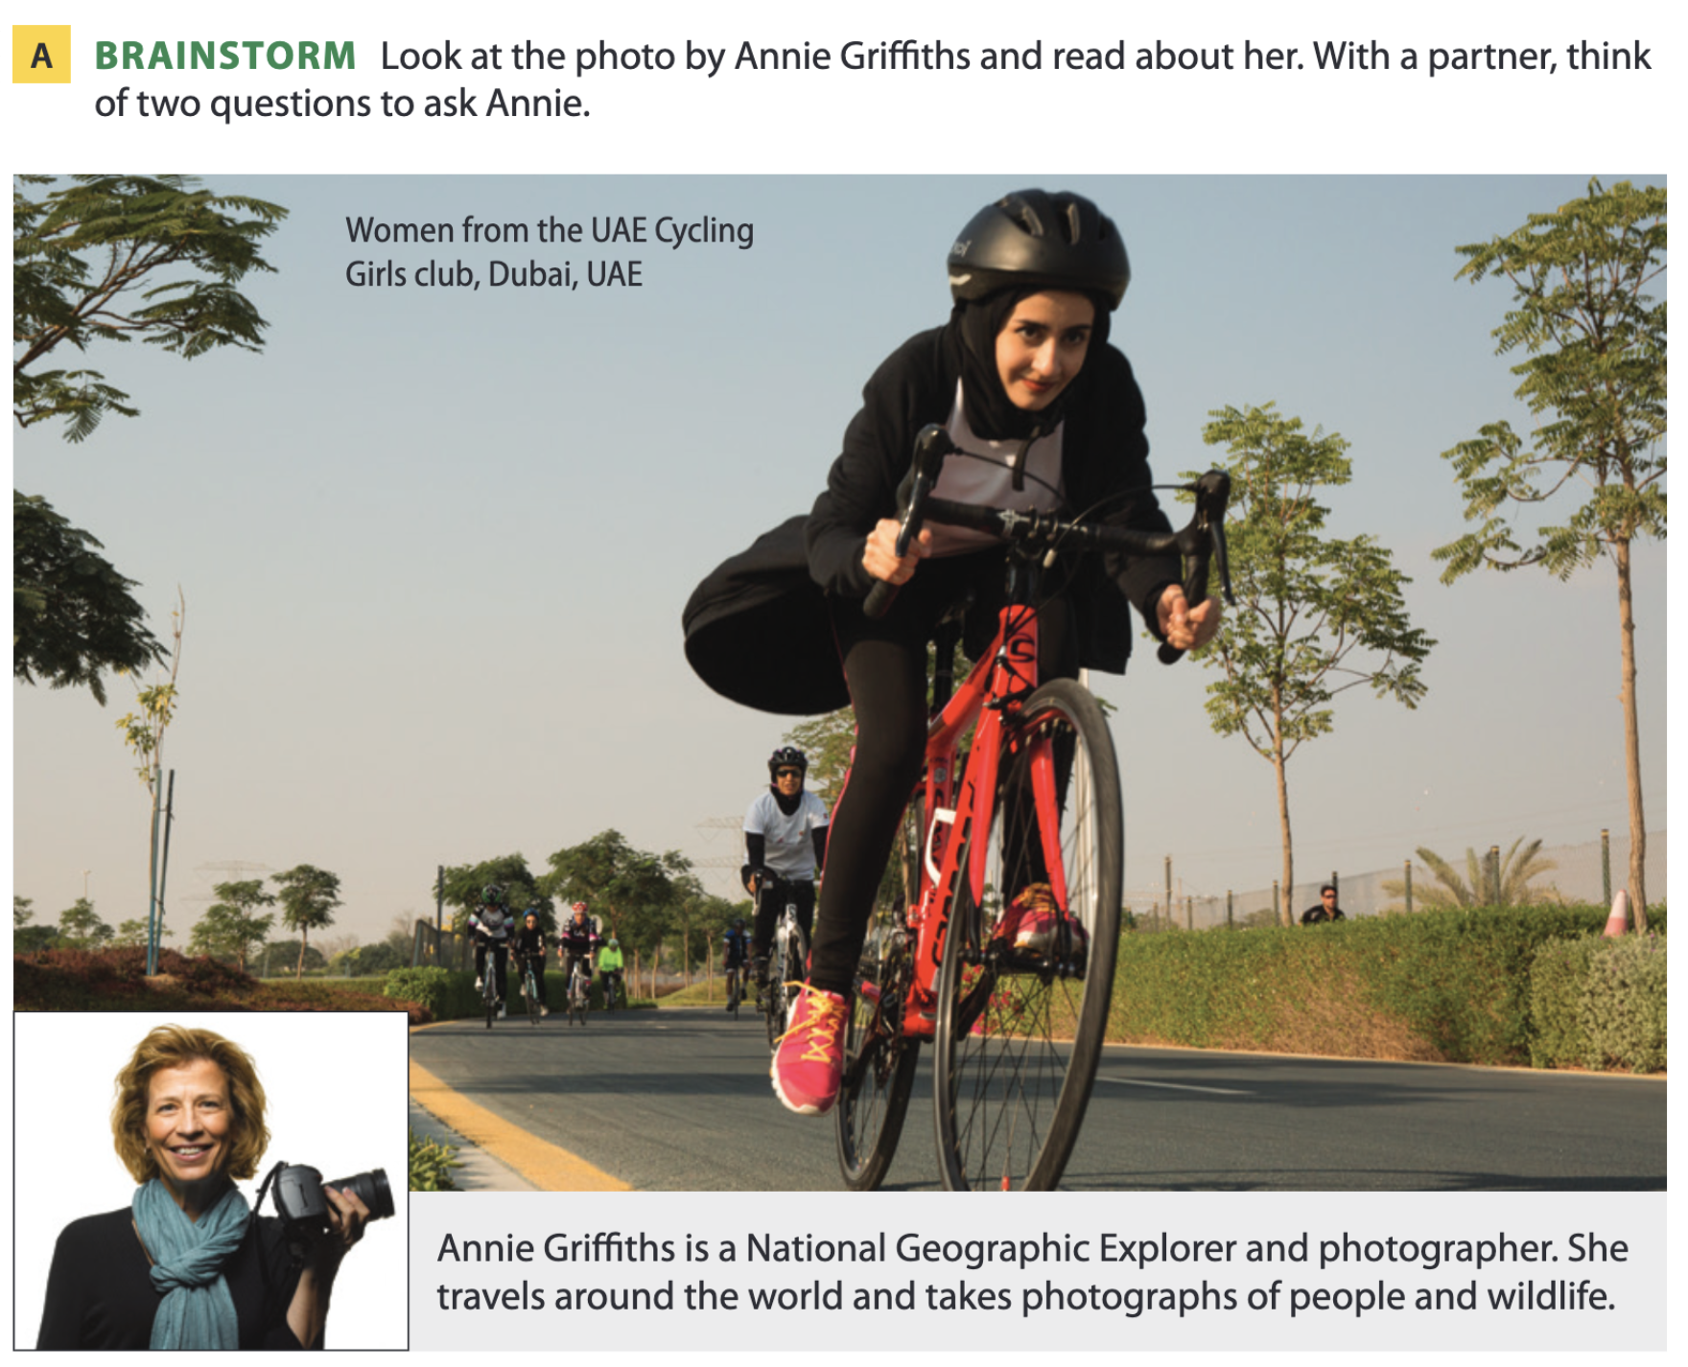
An interview with Annie Griffiths
Page 6
Possible answers:
Where is Annie from?
What does she photograph?
Does she photograph animals or people?
Which countries does she travel to?
Is her job dangerous?

Slide 19
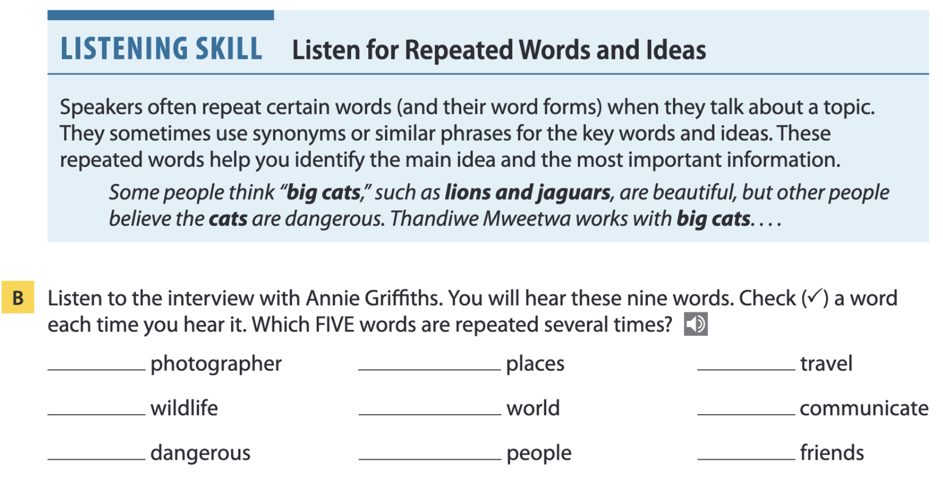
Page 6

Slide 20

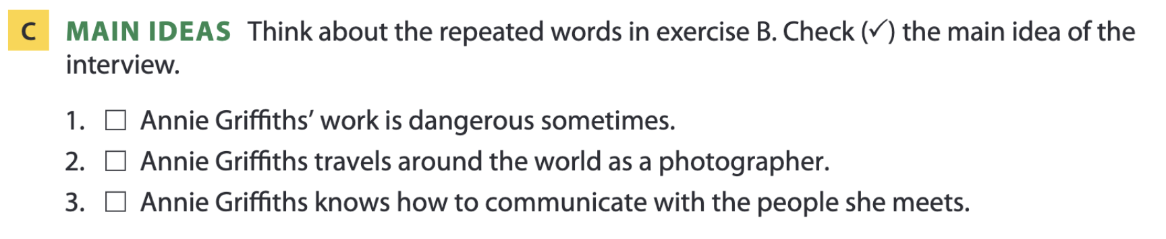
Pages 6-7

Slide 21
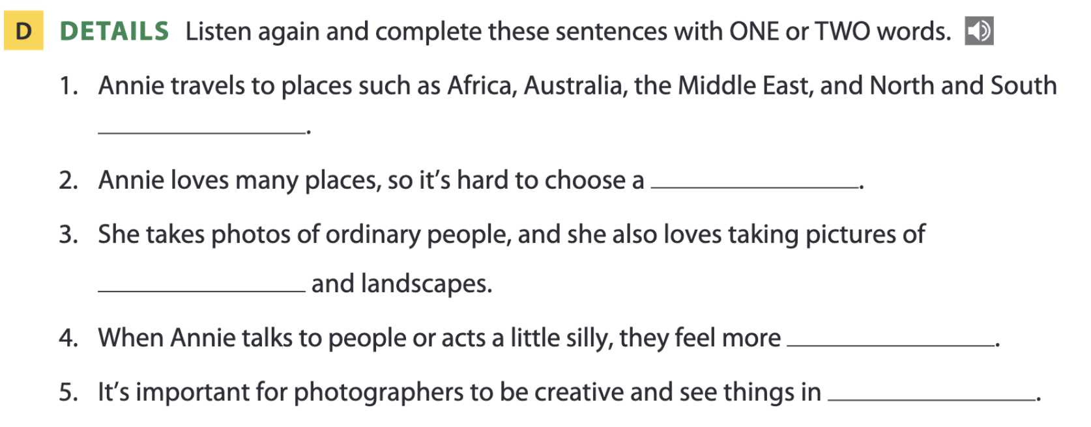
Page 7
America
favorite
wildlife
relaxed
new ways

Slide 22
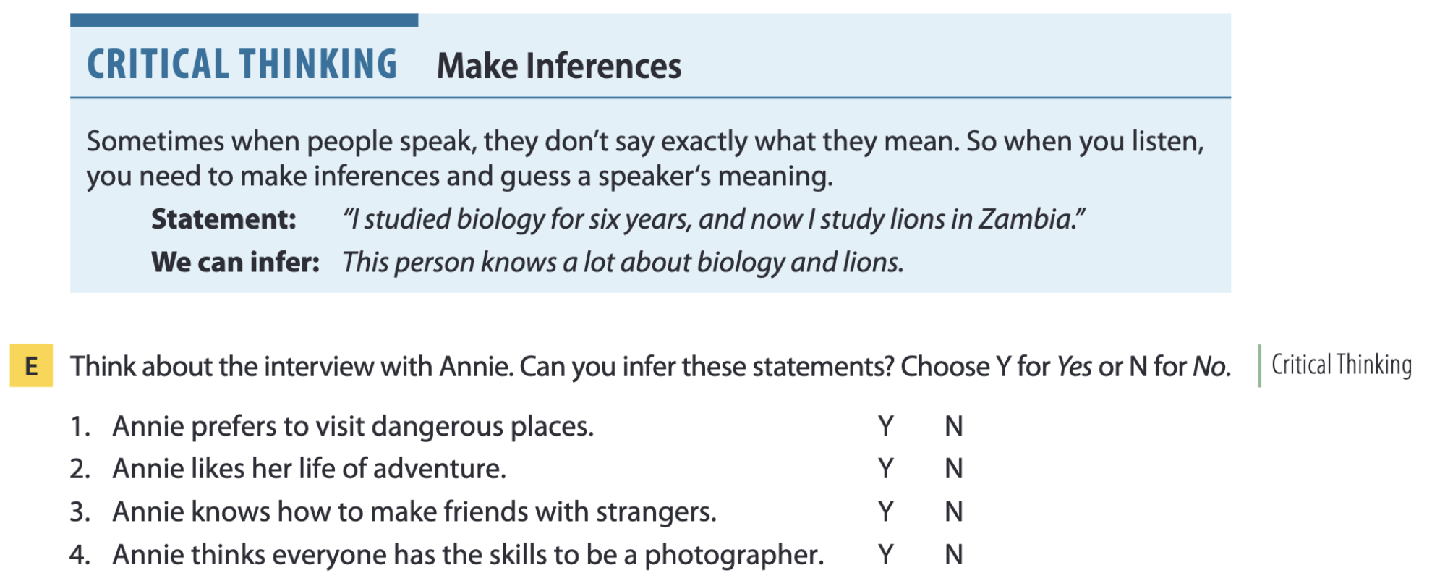
Page 7

Slide 23
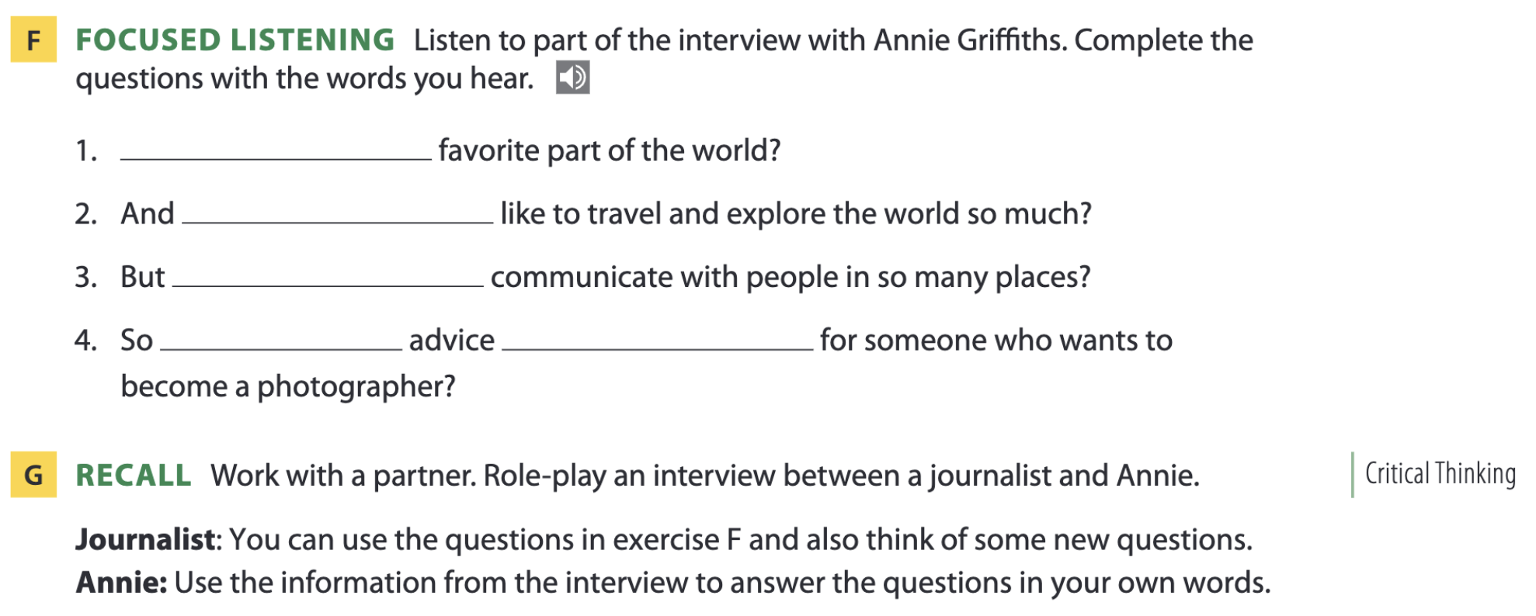
Page 7
What’s your
why do you
how do you
what
do you have

Slide 24

03
Video watching

Slide 25
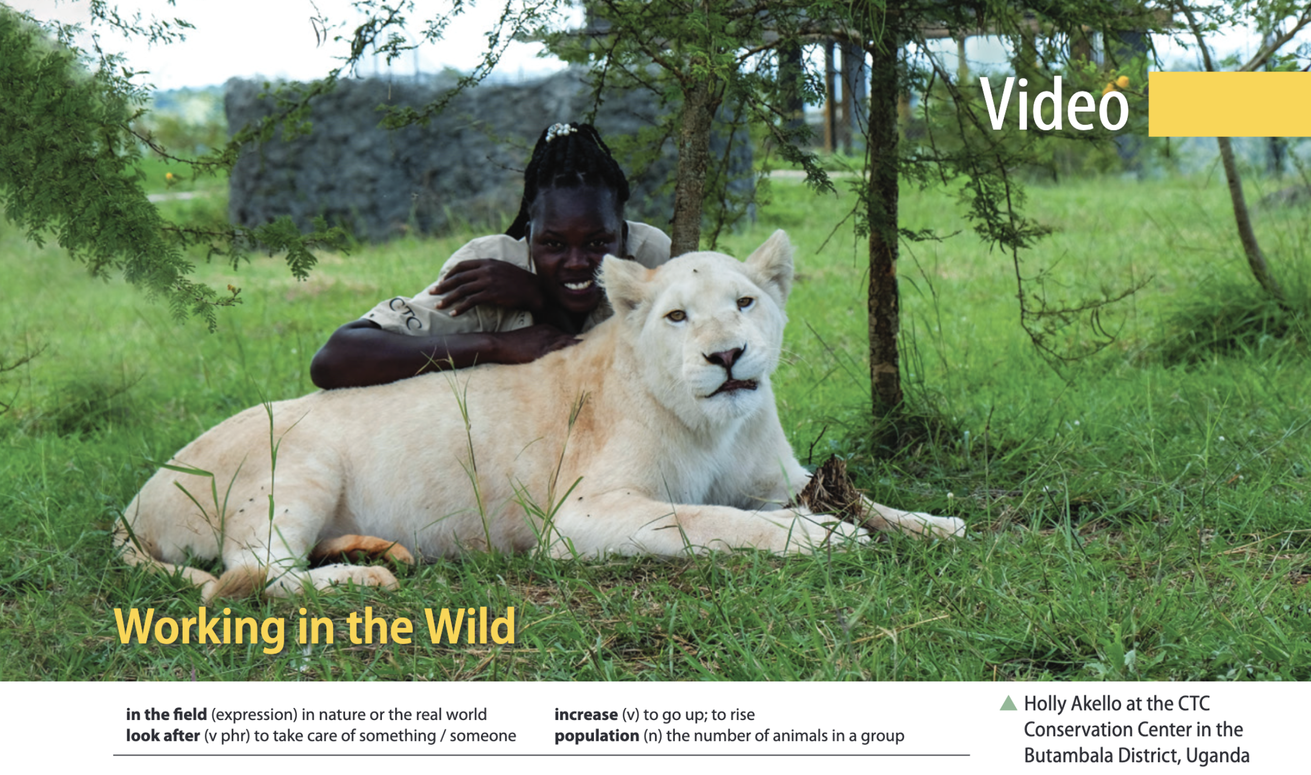

Slide 26
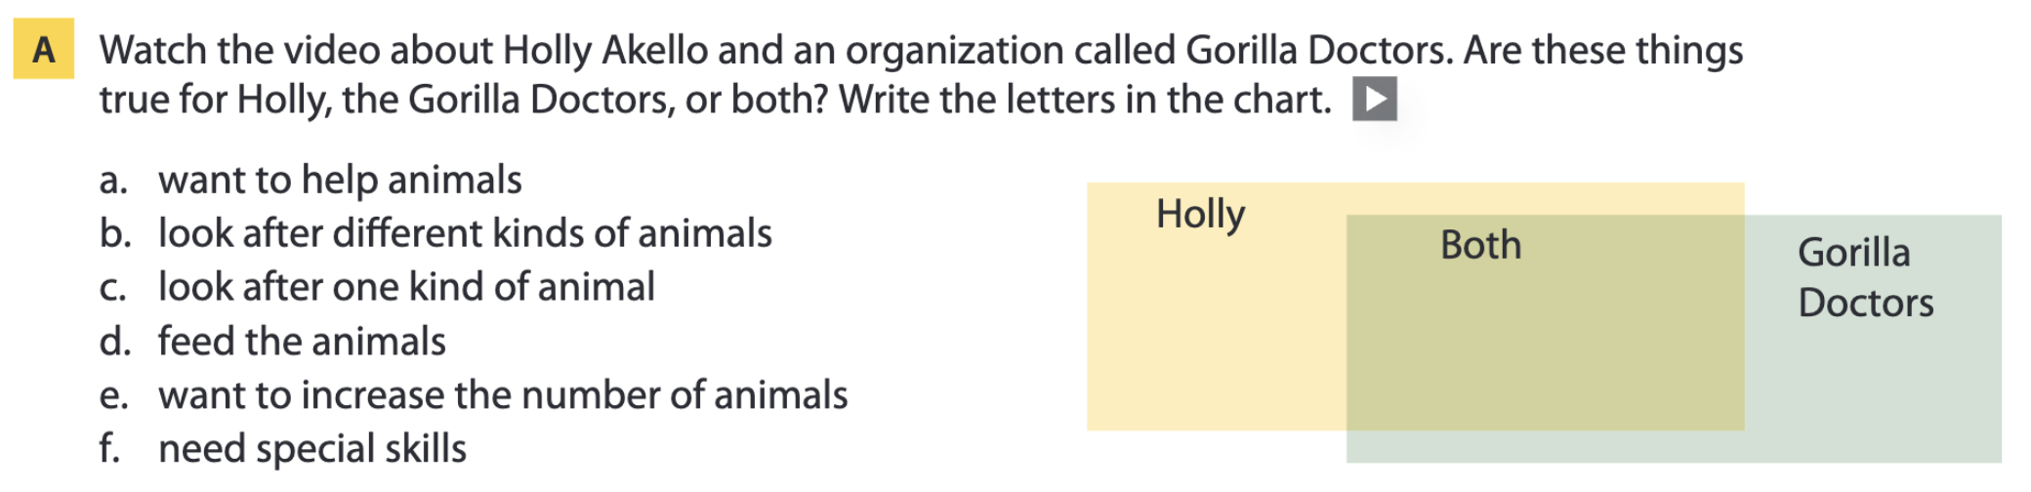
Page 11
b, d
a, f
c, e

Slide 27
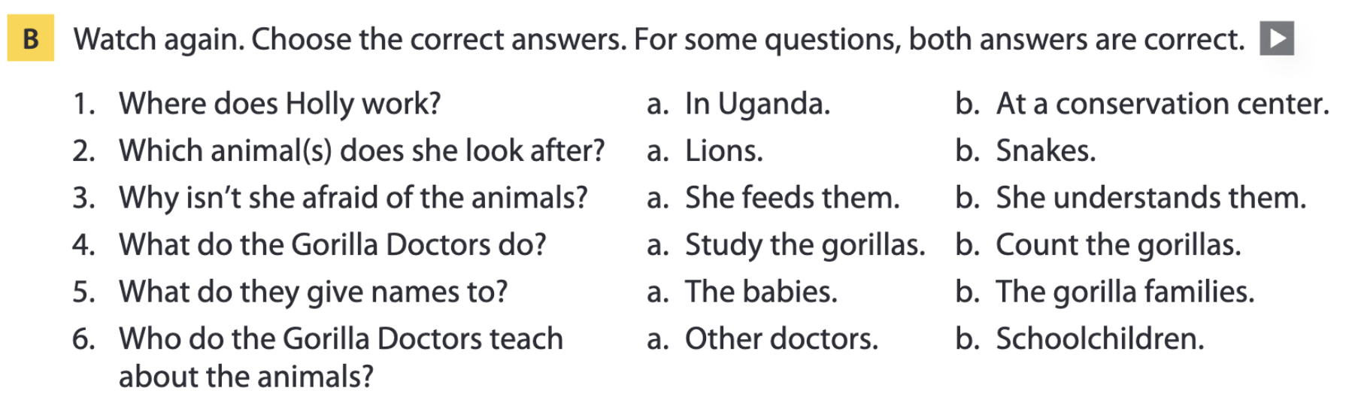
Page 11

Slide 28
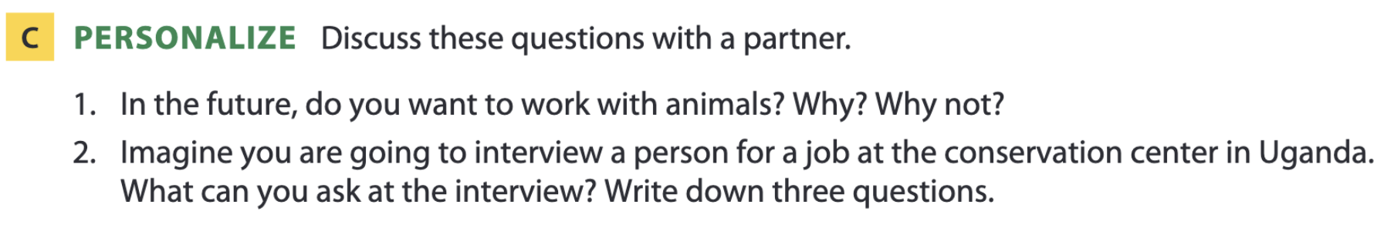
Page 11

Slide 29
04
Vocabulary B

Slide 30
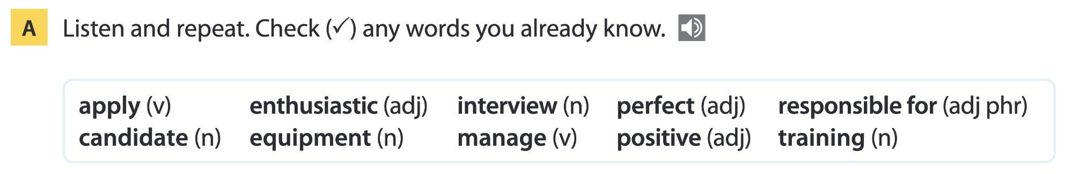
Page 12

Slide 31
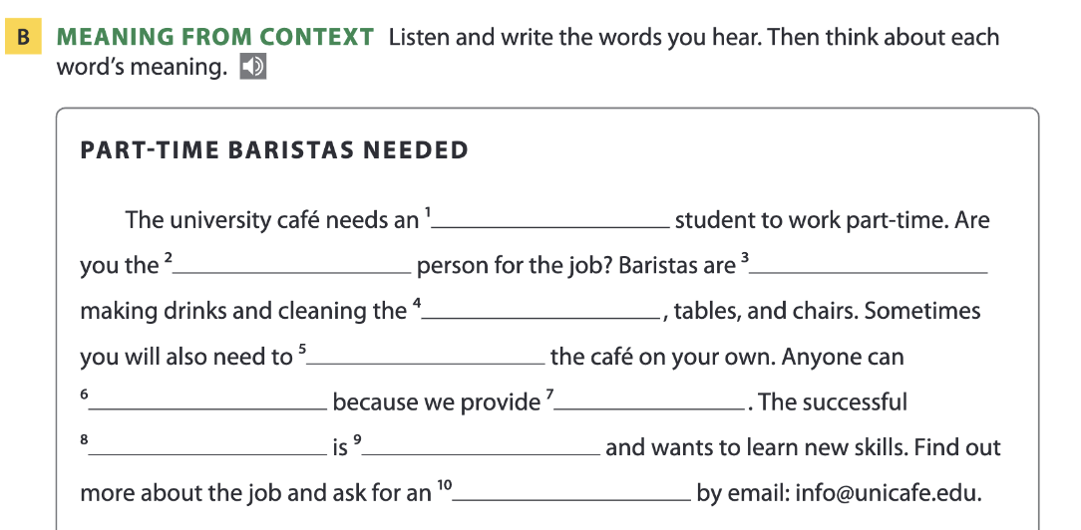
Page 12
enthusiastic
perfect
responsible for
equipment
manage
apply
training
positive
candidate
interview

Slide 32
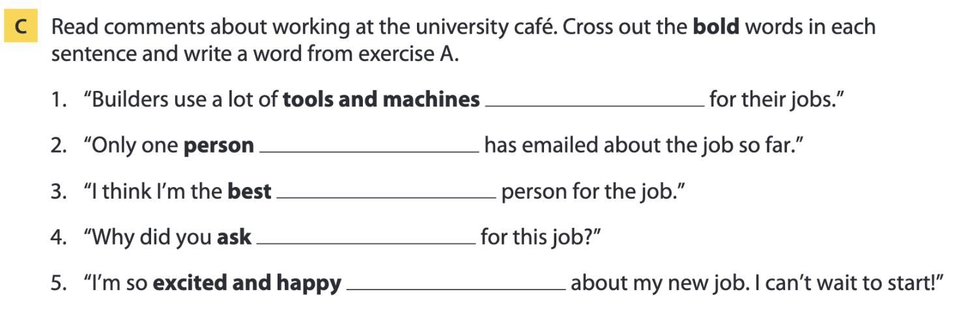
Page 13
equipment
candidate
perfect
apply
enthusiastic

Slide 33
Vocabulary list
enthusiastic /ɪnˌθjuː.ziˈæs.tɪk/ (adj) – nhiệt tình
perfect /ˈpɜː.fekt/ (adj) – hoàn hảo
responsible for /rɪˈspɒn.sə.bəl/ (adj phr) – chịu trách nhiệm về
equipment /ɪˈkwɪp.mənt/ (n) – thiết bị
manage /ˈmæn.ɪdʒ/ (v) – quản lý
apply /əˈplaɪ/ (v) – nộp đơn, ứng tuyển
training /ˈtreɪ.nɪŋ/ (n) – khóa đào tạo
candidate /ˈkæn.dɪ.dət/ (n) – ứng viên
positive /ˈpɒz.ə.tɪv/ (adj) – tích cực
interview /ˈɪn.tə.vjuː/ (n) – buổi phỏng vấn

Slide 34
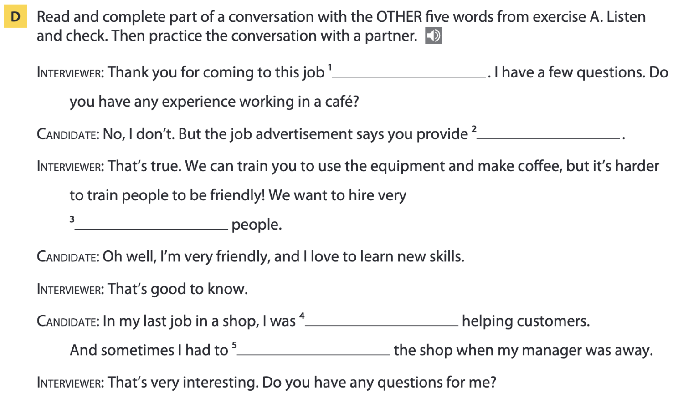
Page 13
interview
training
positive
responsible for
manage

Slide 35
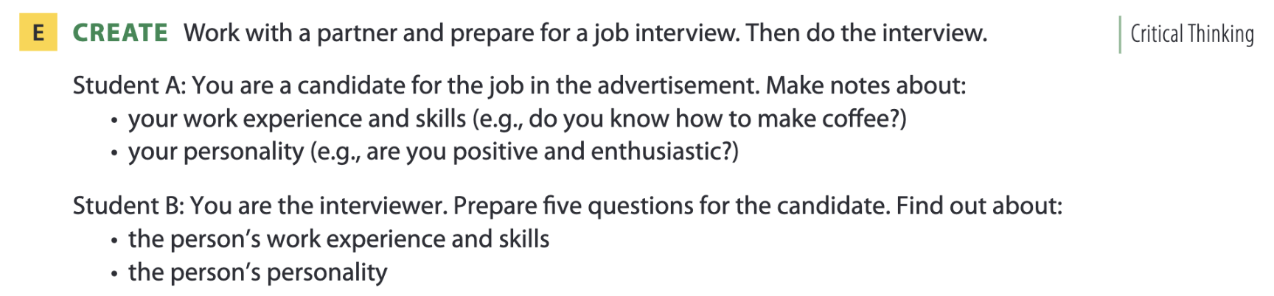
Page 13

Slide 36
05
Listening B

Slide 37

What does it take to be an explorer?
Page 14
Possible answers: travel, people, places, photography, dangerous (situations), language, communication

Slide 38
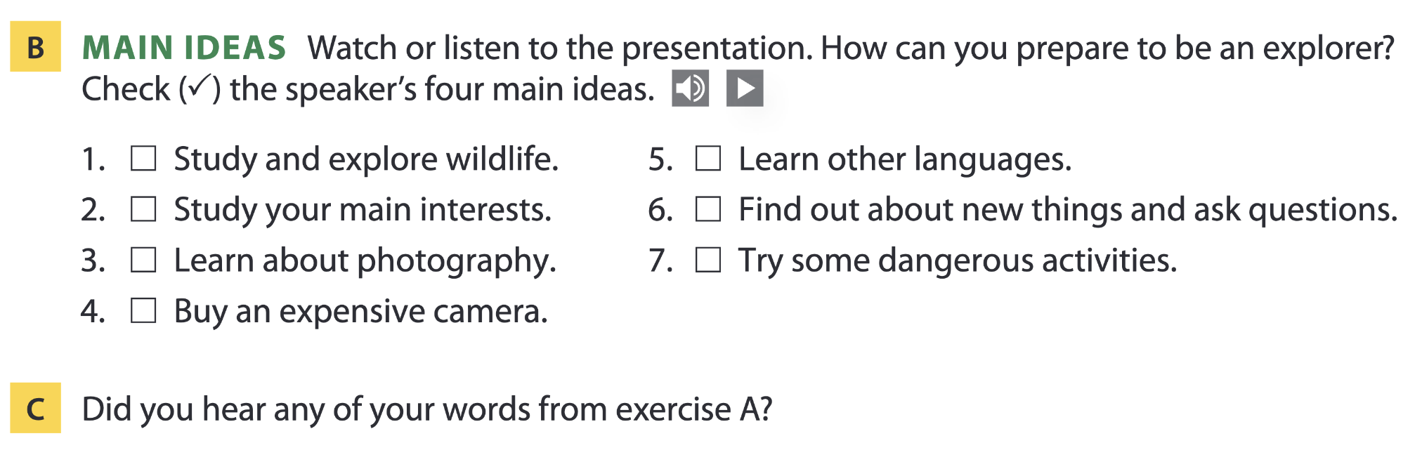
Page 14

Slide 39
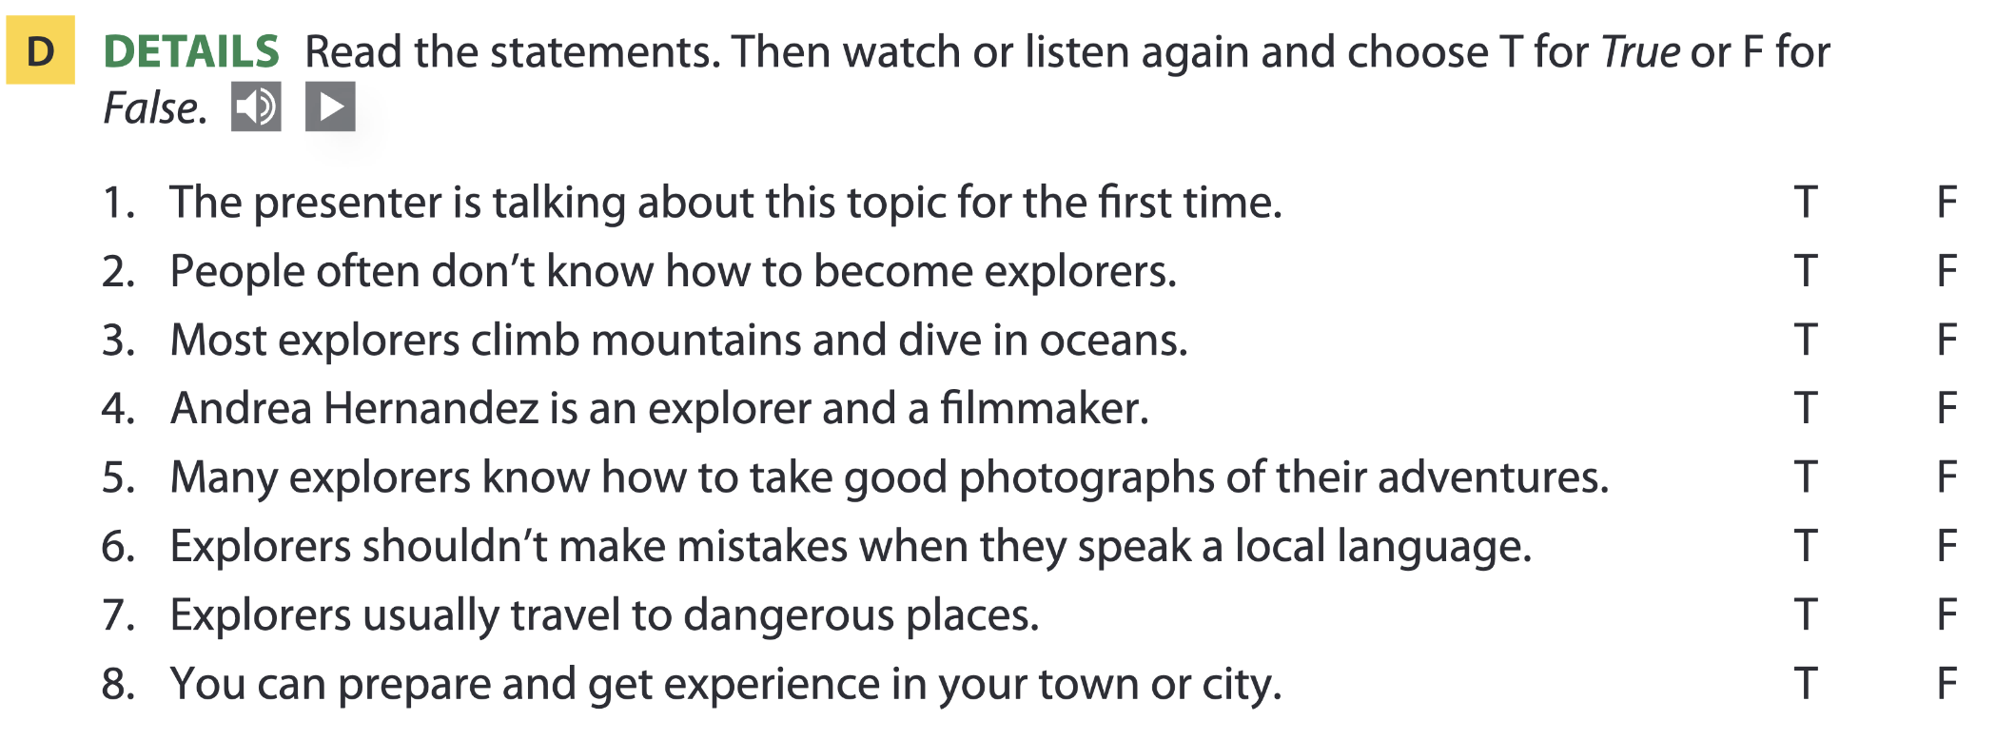
Page 14

Slide 40
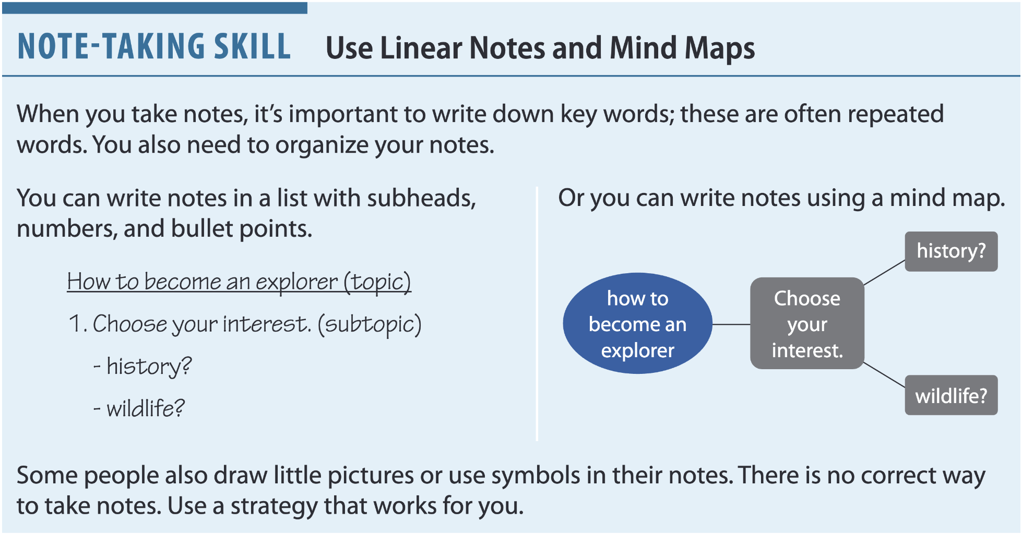
Page 14

Slide 41
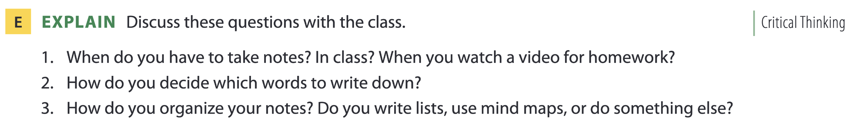
Page 15

Slide 42
Page 15
Possible answers:
How to become an explorer
1. Learn about photography
- Look at NG photos
- Take a class
- Practice taking pictures
2. Languages
- Think about the countries you want to explore
- Learn a few words of the local language
- Find a teacher or use an app

Slide 43
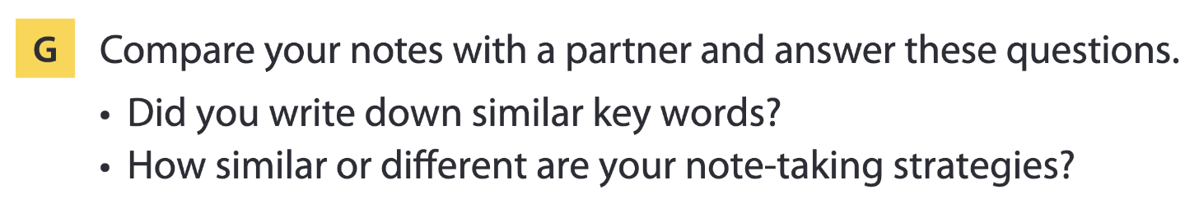
Page 15

Slide 44
THANKS FOR YOUR ATTENTION!

